Slide 1


Welcome to HTML & CSS!
Embark on your journey into the world of web development! This presentation will cover the fundamentals of HTML and CSS, empowering you to build your own interactive websites. We'll explore the core concepts, then dive into hands-on projects to solidify your understanding.
by Nandan Chowdhury

Slide 2
What is HTML? (HyperText Markup Language)
Structure of a Webpage
HTML Elements
Think of HTML as the blueprint of a webpage, defining the arrangement and content.
Each element serves a specific purpose, like headings (`
`), paragraphs (``), images (``), and links (``). There are over 140 elements available, each playing a crucial role.

Slide 3
What is CSS? (Cascading Style Sheets)
Styling a Webpage
CSS Properties
CSS takes care of the visual appearance, controlling elements' colors, fonts, layouts, and more.
There are over 200 CSS properties available, allowing you to fine-tune every detail. Examples include `color`, `font-size`, and `margin`.

Slide 4

HTML & CSS Working Together
1
Linking CSS
2
The CSS Cascade
The `` tag connects your HTML file to a CSS file, instructing the browser to apply those styles.
Understanding inheritance and specificity ensures styles are applied correctly, giving precedence to more specific rules.
3
Common Styles
There are common CSS styles associated with HTML elements, like font size for headings and text decoration for links.

Slide 5



Project 1: Welcome To - Football World
Use a code editor like VS Code, Sublime Text, or Atom for efficient coding.
Use HTML & CSS validators to ensure your code is error-free.
Utilize browser developer tools to inspect and modify your HTML & CSS in real-time.

Slide 6
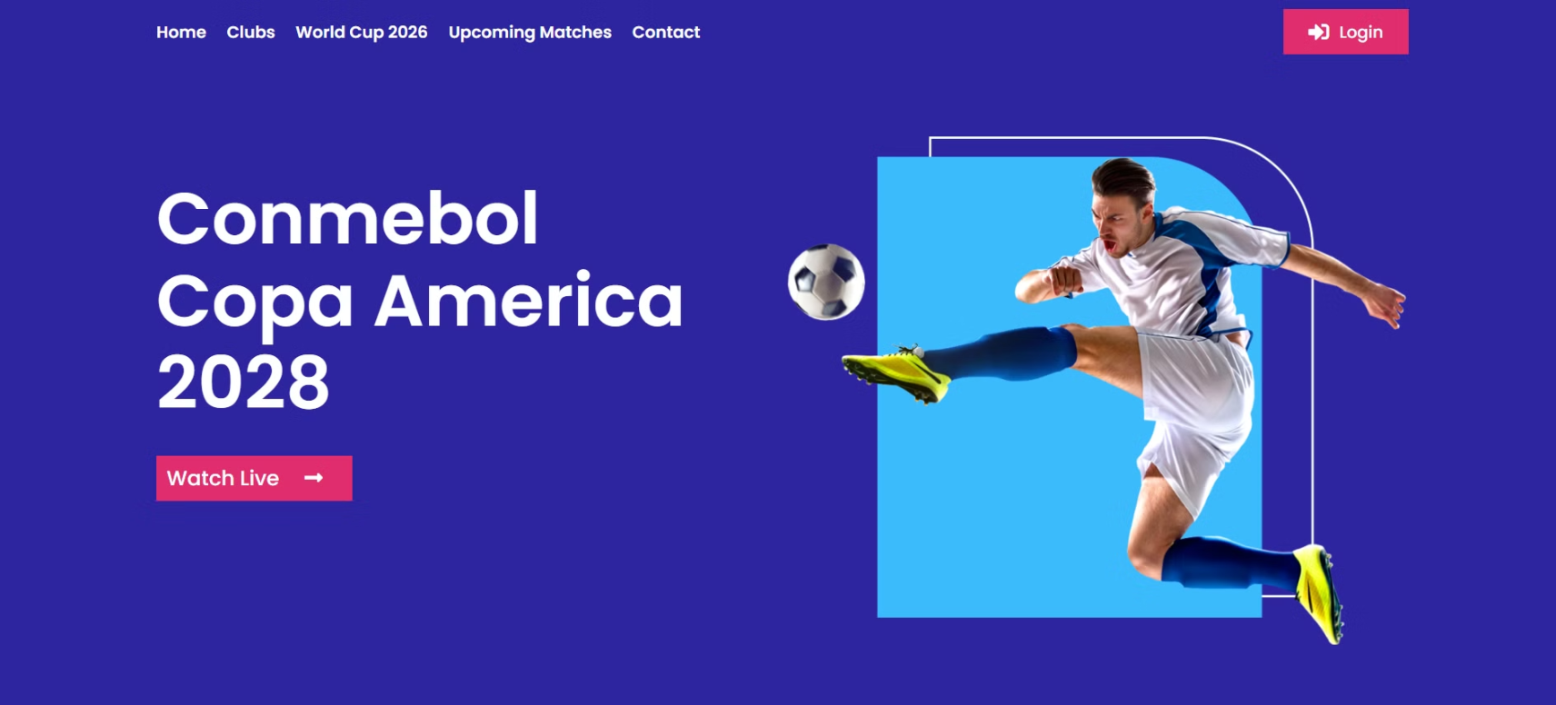

Slide 7
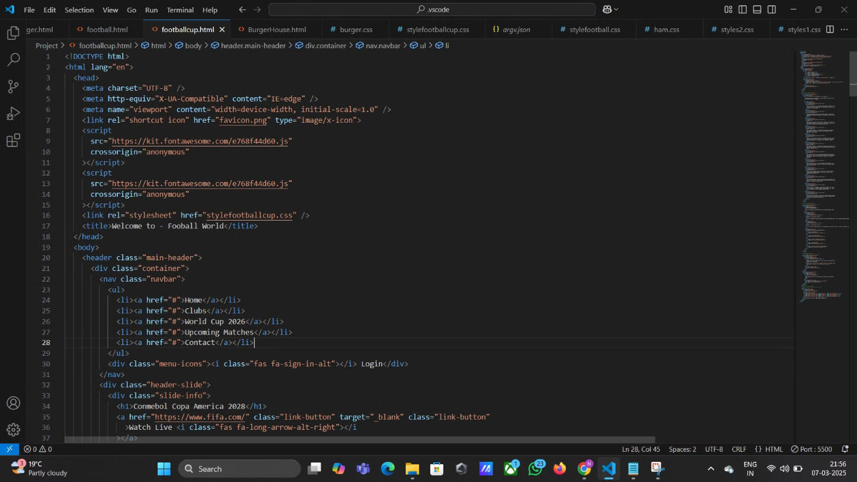
The Code:[HTML]

Slide 8
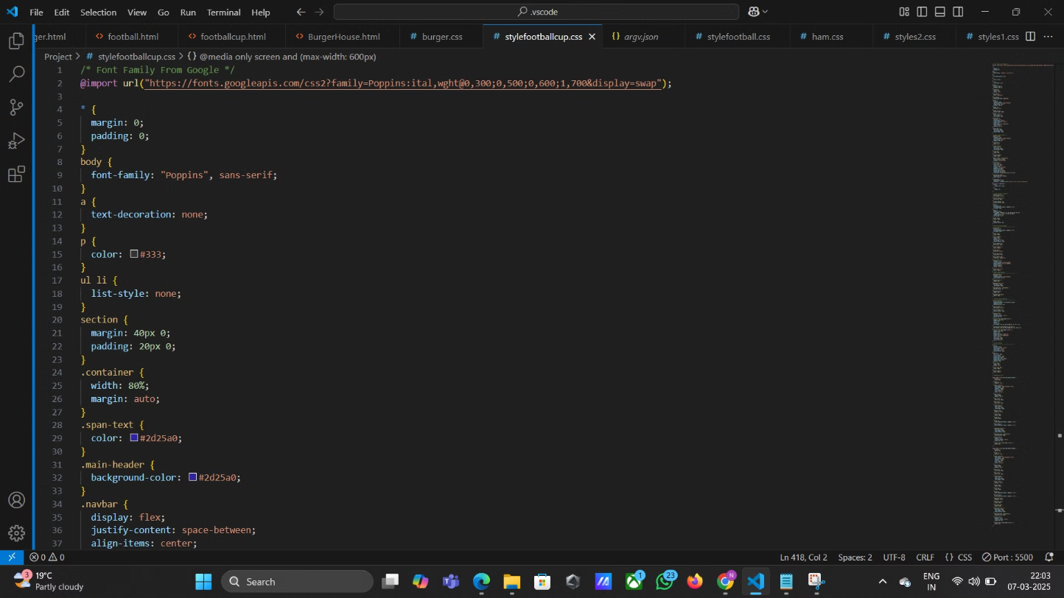
The Code:[CSS]

Slide 9
Project 2: Burger House
Responsive Design
CSS Styling
Make your landing page responsive to different screen sizes using media queries.
HTML Structure
Style the button, add spacing and padding, use an appealing font, add a gradient background, and consider flexbox or grid layout.
Create a landing page with a heading, product description, image, and button to "Learn More" or "Buy Now".

Slide 10
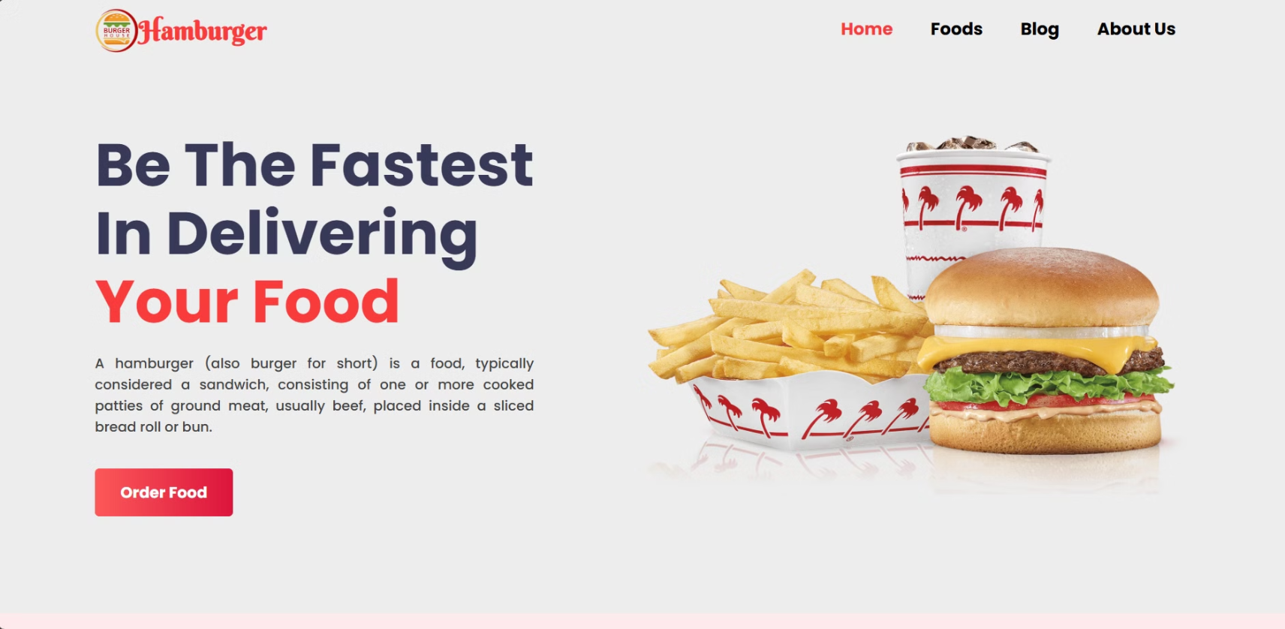

Slide 11
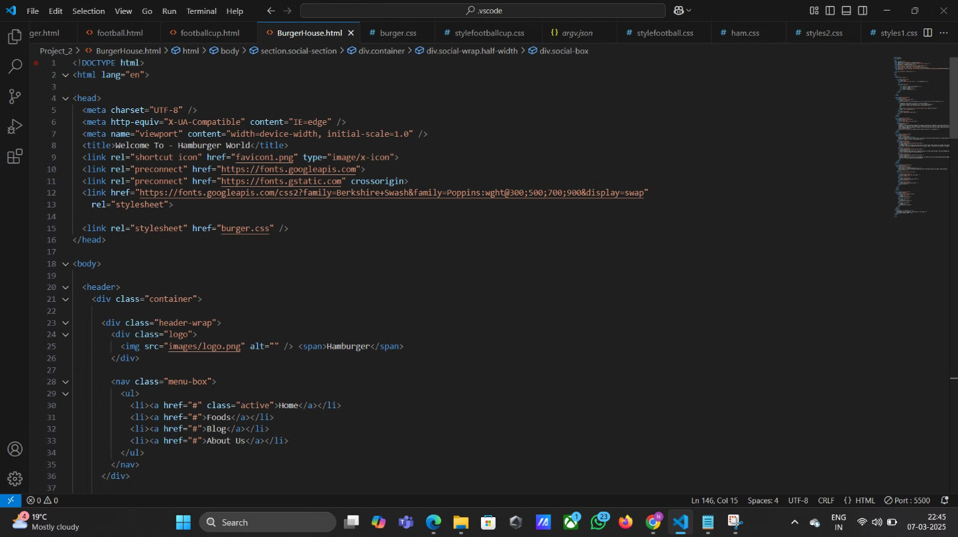
The Code:[HTML]

Slide 12
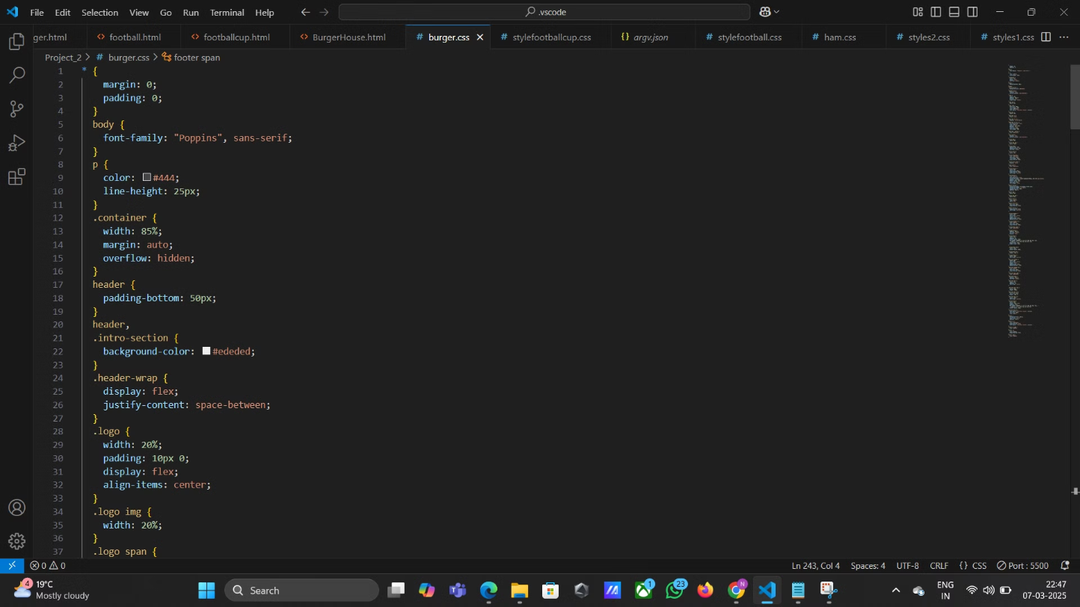
The Code:[CSS]

Slide 13
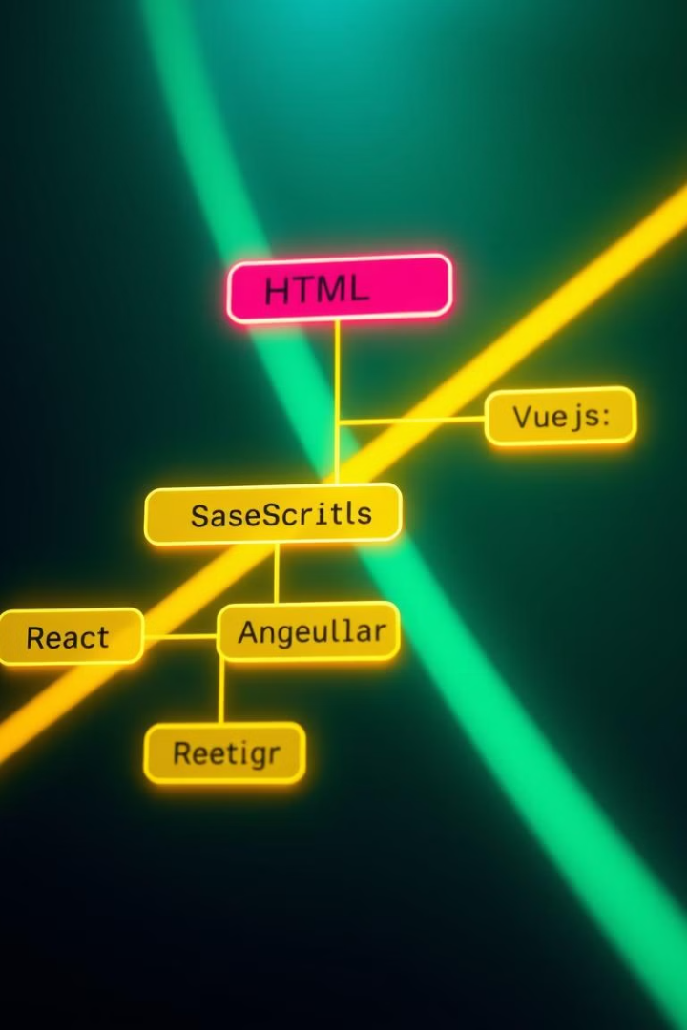
Next Steps and Resources
1
Practice
The key to mastery is practice. Keep experimenting and building your skills.
2
Online Resources
Explore MDN Web Docs, freeCodeCamp, CodePen, CSS-Tricks, and Stack Overflow for learning and support.
3
Next Steps
Continue your learning journey by exploring JavaScript for interactivity and popular frameworks like React, Angular, or Vue.js.

Slide 14


